Slide 1

ANLY 506 Exec Format 1
Sourcing Data and Pre-Processing

Slide 2
Lecture Outline
Part 1 Sourcing Data
Sourcing Data Basics
Intro to R
Data Structures
Reading in data locally
Reading in data from URL
Databases, SQL, and APIs
Databases and Relational Data Model
SQL language, using SQL locally
APIs, reading in data from API
Webscraping
Overview
Reading in data by web scraping

Slide 3
Lecture Outline
Part 2 Pre-Processing
Variable Types
Representation
Transforming Variables
Missing Values
3 approaches for addressing
Performing Large Operations
Across Variables
Across Datasets

Slide 4
Introductions
Name
Where you’re from
Career interests/ What you plan on studying
Fun fact/ Hobby

Slide 5
Part 1: Sourcing Data

Slide 6
Sourcing Data Basics

Slide 7
Steps in the EDA Pipeline
Discovery
Research Design
Data
Search
Analysis
Pre-Processing
Processing/Analysis
Results
Conclusions

Slide 8
Data Sources
Kaggle.com – Data and competitions
Data.world
Github.com
UCI Machine Learning Repository
http://archive.ics.uci.edu/ml/index.php
Forbes 2016 list
https://www.forbes.com/sites/bernardmarr/2016/02/12/big-data-35-brilliant-and-free-data-sources-for-2016/#781feb32b54d

Slide 9


Setup – R and R Studio
Check version of R using version
If <3.3.1 then update R and R Studio
Install R:
Windows: https://cran.r-project.org/bin/windows/base/
Mac: https://cran.r-project.org/bin/macosx/
Install R Studio: https://www.rstudio.com/products/rstudio/download/#download

Slide 10
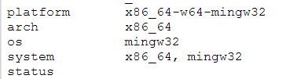
Setup - Java
Many R packages require Java.
Install rJava – If errors, need to update Java.
if(!require("rJava")){install.packages("rJava")}
library("rJava")
Java version MUST MATCH version of R
32 bit R requires 32 bit Java
64 bit R requries 64 bit Java
Check version of R using version
Download java here: https://www.java.com/en/download/manual.jsp
64 bit

Slide 11
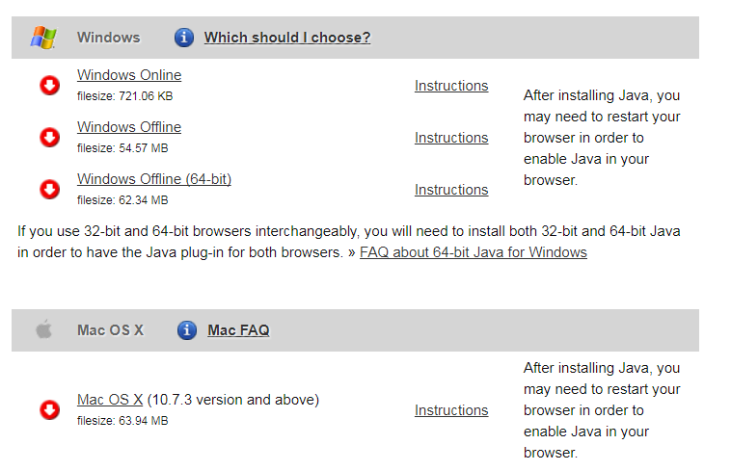
Setup - Java
32 bit
64 bit
64 bit (no 32 bit)

Slide 12
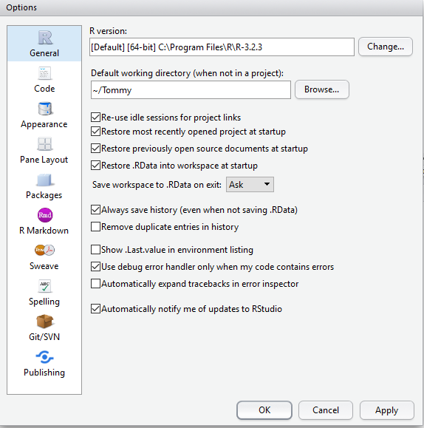
Getting Started – Set Default Working Directory
Go to Tools>Global Options
Under Default working directory hit Browse and select the folder you would like
Restart R Studio
To temporarily change the working directory later, use setwd(“path”), replacing all / with //

Slide 13
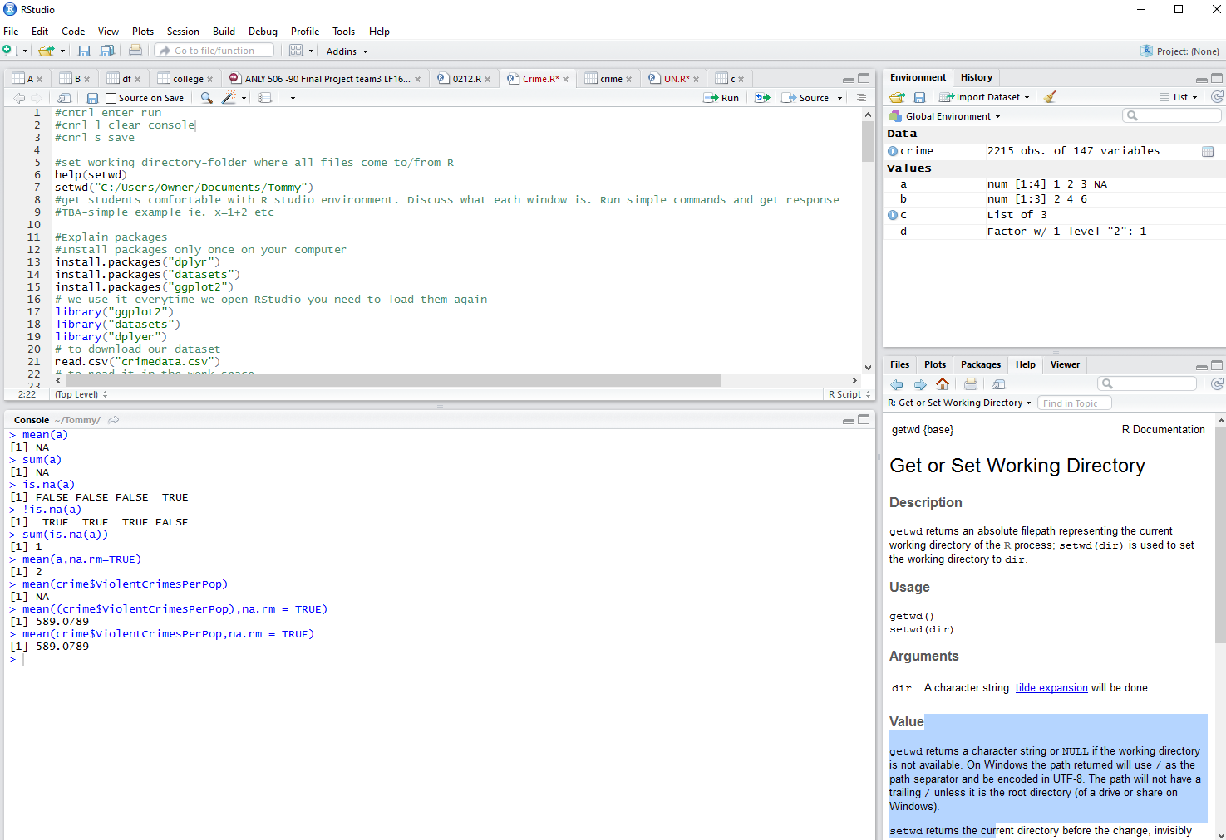
Script: will run most commands from here
Global Environment/Workspace: All defined Data and Values will appear here
Console/Log: Displays commands which have been run. Can also run commands directly in console.
Here you can see files, plots, packages (libraries), and the help view.

Slide 14
Getting Started – Examples
Use either = or <- for the assignment operator
R is case sensitive
To create a vector use c(value1, value2, … n)
A few simple examples
X <- 3 #assign X the value 3
X = 3 #same as previous line
vector = c(1, 2, 3, 4) #define a vector
vector2 = vector*2 #scale the vector
Y = max(vector2) #assign m to the max of vector 2 (8)
Z = “This is a string” #assign Z to a string
Z == Y #returns a Logical/Boolean (FALSE)

Slide 15
Built in Datasets in R
View all built in datasets in R
data ()
Read in data from built in dataset
data(mtcars)
The dataset will appear as a dataframe once it's used
Summary provides the min, 1st quartile, mean, 3rd quartile, and max for every variable in the dataset
summary(mtcars)
Get the names of all variables in the dataset
names(mtcars)
Get a summary for just one variable
summary(mtcars$mpg)

Slide 16
Getting Started - Subsetting
Subsetting – Taking part of the data based on some condition(s)
General form: data [ rowCondition , columnCondition ]
First row: mtcars [ 1 , ]
Second column: mtcars [ , 2]
Subset data into 2 new datasets based on mpg
EnvironmentalCars=mtcars[mtcars$mpg>20,]
notEnvironmentalCars=mtcars[mtcars$mpg<=20,]
Compare horsepower for 2 subsets
summary(EnvironmentalCars$hp)
summary(notEnvironmentalCars$hp)

Slide 17
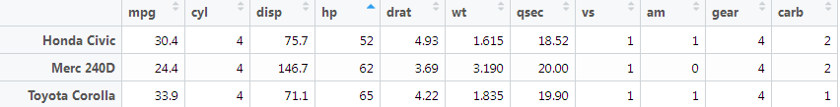
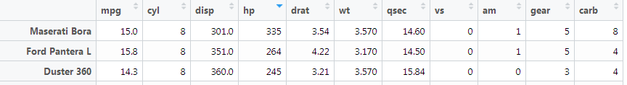
Getting Started - Sorting
Open a dataframe and click on any variable to sort by that variable, in ascending order.
Cars with lowest horsepower:
Click on the variable again to sort in descending order.
Cars with highest horsepower:

Slide 18
Data Structures
Delimeter = character which separates values in data
Name | Age | Weight
Jim | 20 | 140
Bob | 32 | 180
Name,Age,Weight
Jim,20,140
Bob,32,180
Standard representation
CSV representation
.csv - Comma Separated Value – Variables are separated by commas
.txt - Text file – Variables can be separated by many types of delimeters
.xlsx – Excel file – Can include extensive fomatting and calculation information. This information is not retained when importing to R or other languages

Slide 19
Importing Local Data with R
Read csv file
Dataset includes many features of houses which can be used to predict their value
houses = read.csv ("houses.csv")
Only read in first 100 rows
houses2 = read.csv ("houses.csv",nrows=100)
Read txt file
Dataset includes attributes of songs which can be used to predict which year the song was released
music = read.table (“music.txt", sep=“ ”)
Only read in first 100 rows
music = read.table (“music.txt", sep=“ ”, nrows=100)

Slide 20
Importing Data
What is the size of the houses and music datasets (#rows and columns)?
What is the average year that the houses were built?
What is the range of V2 in the music data?
What is the average weight of the chickens in the built in dataset ChickWeight?

Slide 21
Importing Local Data with R (cont.)
Read xlsx file
“xlsx” package and many others require Java.
Download java here: https://www.java.com/en/download/manual.jsp
Install xlsx package if not already installed
if(!require("xlsx")){install.packages("xlsx")}
Load package
library(xlsx)
Read xlsx file, 2nd argument is sheet number
housesFromExcel = read.xlsx2 ("housesExcel.xlsx", 1)

Slide 22
Importing Data from URL with R
Read csv from url
fires = read.csv (url ( “http://archive.ics.uci.edu/ml/machine-learning-databases/forest-fires/forestfires.csv” ) )
Only read in the first 100 rows
fires = read.csv (url ( “http://archive.ics.uci.edu/ml/machine-learning-databases/forest-fires/forestfires.csv” ) , nrows=100 )

Slide 23
Databases, SQL, and APIs

Slide 24
Databases
Database- Organized collection of data
Database Management System (DBMS) – Computer application which allows the definition, creation, querying, update, and administration of databases
Relational DBMS (RDMS) - The most common DBMS, built using the relational data model
Query – Request to pull specific data
Specify dataset, variable, logical conditions

Slide 25
Sourcing Data from Databases
Advantage over static data (i.e. csv)
Can continually and automatically pull data
Can pull data which you might not be able to find elsewhere
SQL – Usually used to write data in and out of database that you own
API – Used to pull data from a database which you don’t own

Slide 26
Relational Data Model
Tables in RDMS = Dataframes in R
Rows are observations
Columns are variables
Number of rows is same for all columns
Keys are used to identify and link data
Primary Key − Uniquely identifies each row/record in a database table
Foreign Key − Uniquely identifies a row/record in any another database table

Slide 27
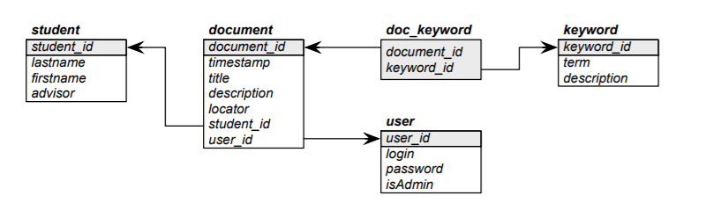
Relational Data Model
Each box above represents a separate table, with the variables displayed.
Primary keys for each table are highlighted in gray (student_id is a primary key for the student table)
Foreign keys for each table are shown with arrows (student_id is a foreign key for the document table)

Slide 28
SQL
Computer programming language designed to run queries for Databases
Most widely used database language
Can be integrated with R using several packages
Can be used in R:
To read data into and out of a database which you own
To query data locally. Can be much faster than reading in entire dataset, then subsetting

Slide 29
Using SQL Locally - SQLDF
sqldf() queries from a dataframe which already exists in your global environment. Same as subsetting with base R.
sqldf(“select vars from dataframe where logical condition is met)
vars – list variables or use * for all
dataframe – name of dataframe in R
Logical condition – Conditions which subset the data

Slide 30
Using SQL Locally - SQLDF
Install sqldf package if not already installed
if(!require("sqldf")){install.packages("sqldf")}
Load package
library(sqldf)
Select all variables (* = all) with mpg >20
sqldf("SELECT * FROM mtcars WHERE mpg > 20")

Slide 31
Using SQL Locally - Read in csv
read.csv.sql() is used to query a csv file as it’s read in. This is more efficient than reading in and then subsetting.
Read in a subset of a csv using read.csv.sql
expensiveHouses =
read.csv.sql ("houses.csv", sql="select * from file where SalePrice < 200000", eol="\n")

Slide 32


Slide 33
Application Programming Interfaces (APIs)
APIs are the way to pull data from a database which you don’t own.
In general, APIs are the way in which code can be used to interact with applications, or applications can interact with other applications. Almost all major applications have APIs (Facebook, Uber, Google Maps)
APIs will usually have a contract that limits the use of the data (ex: no commercial use). They will also usually directly limit the data that you can access through the API

Slide 34
Application Programming Interfaces (APIs)
Example 1: Pokemon Go
The makers of Pokemon Go didn’t create a map of the world; they use Google Maps. When a user interacts with the Pokemon Go app, the Pokemon Go app interacts with the Google Maps API.
Example 2: Twitter
A data scientist is interested in analyzing Donald Trump’s tweets using Natural Language Processing techniques. He uses the Twitter API to pull Trump’s tweets directly from Twitter’s database into R for analysis.

Slide 35
Importing Data from API with R
Quandl – Site which offers large amount of financial data for free. Some types of data cost money.
https://www.quandl.com/
Quandl has an R package which makes it very easy to interact with the API. Other APIs will take more effort.
Install Quandl package
if(!require("Quandl")){install.packages("Quandl")}
library(Quandl)
Pull in daily stock prices for AAPL stock
AAPLData = Quandl("WIKI/AAPL")

Slide 36
Web Scraping

Slide 37

Web Scraping
Warning: You can get into a lot of trouble for web scraping in some cases.
Ex: Craigslist, ticket bots
Exercise caution when web scraping – Best idea is to refrain from using scraped data for commercial use.
Web scraping is the act of pulling public data from the web which is contained in HTML format
This data can then be “parsed” – taken from HTML into a typical data format for analysis

Slide 38
Webscraping in R
Let’s pull the list of all of the historical Super Bowl winners from ESPN’s website.
Install required packages
if(!require('tidyr')){install.packages('tidyr')}
if(!require('stringr')){install.packages('stringr')}
if(!require('rvest')){install.packages('rvest')}
Download html data
url = 'http://espn.go.com/nfl/superbowl/history/winners'
webpage = read_html(url)
Extract all of the tables from the html
sb_table = html_nodes(webpage, 'table')
Convert to dataframe
sb = html_table(sb_table)[[1]]

Slide 39
Sourcing Data
Group Exercise
Form groups of 4-5
Be prepared to present for 2 minutes on results
Find an interesting data source from independent research or using Slide 8.
Read the data into R and report on some interesting information found from the data summary.
What method of reading in data did you use? What problems did you run into with this exercise?

Slide 40
Sourcing Data – Summary
Method | R Commands | Requires Internet Connection | Interacts With Database | Uses Queries | Legal Grey Area | Structured Data
Built in datasets | data() |  |  |  |  | Y
Locally | read.csv() - CSV read.table() - TXT read.xlsx2() - XLSX |  |  |  |  | Y
Locally (Using SQL) | sqldf() read.csv.sql() |  |  | Y |  | Y
CSV from URL | read.csv( url() ) | Y |  |  |  | Y
Database (Using SQL) | Various library(RMySQL) library(SQLite) | Y | Y | Y |  | Y
Database (Using API) | Various (depends on API) | Y | Y | Y |  | Y
Web Scraping | read_html() | Y |  |  | Y

Slide 41
Part 2: Pre-Processing

Slide 42
Steps in the EDA Pipeline
Discovery
Research Design
Data
Search
Analysis
Pre-Processing
Processing/Analysis
Results
Conclusions

Slide 43
Variable Types

Slide 44
Variable Types
Main variable types in R are as follows
Numeric
Integer – Whole number
Double – Decimal
a = c(2,4,6,8)
Character – Text
b = c("Joe","Bob","Jim","Tom")
Logical – TRUE or FALSE are only two possible values
c = c(T,F,F,T)
Factor – Use for categorical variables
d = factor( c("big","small","small","big") )
Date – Used for dates
Use class(X) to ask R the variable type for a given variable, X

Slide 45
Variable Types
What type of variable should each of these be? There may be more than one right answer.
Number grade on a test
Letter grade on a test
Pass/Fail grade on a test.

Slide 46
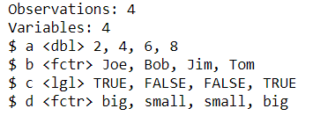
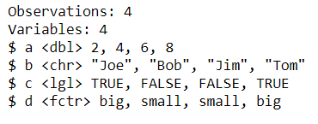
Variable Types
In R, datasets are called dataframes.
Vectors can be combined into a dataframe as long as they are all the same length.
glimpse()
Variable names, variable types, and the first few observations of each variable.
From dplyr, str() from base is similar
df=data.frame(a,b,c,d)
glimpse(df)
df2=data.frame(a,b,c,d,
stringsAsFactors=F)
glimpse(df2)

Slide 47
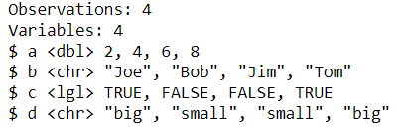
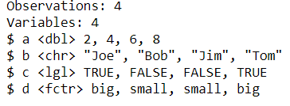
Variable Types
We can convert variable types once the variables are defined.
as.numeric() Convert to numeric
as.character() Convert to character
as.logical() Convert to logical
as.factor() Convert to factor
as.Date() Convert to date
Convert d to character
df2$d=as.character(df2$d)
glimpse(df2)
Convert back to factor
df2$d=as.factor(df2$d)
glimpse(df2)

Slide 48
Variable Types
Read in the dataset “heights.csv”.
What variable types should each variable be best represented as? For variables which aren’t defined correctly when the data is read in, try to define them correctly.
Which variables weren’t defined correctly when you read in the data?
What problems did you run into? Were there variables you weren’t able to define as you wanted?

Slide 49
Missing Values

Slide 50
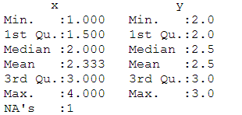
Missing Values
Missing values in R are represented as NA
x=c(1,2,NA,4)
NAs will get in the way of normal operations
sum(x) NA
Find NAs – Returns T/F for whether each observation is NA
is.na(x) F F T F
Find number of NAs for a variable
sum(is.na(x)) 1
y=c(2,2,3,3)
df=data.frame(x,y)
Find number of NAs for a dataset
summary(df)

Slide 51
Missing Values
There are 3 ways to deal with missing values
Omit method - Ignore entire row or column
na.omit()
This is only recommended if the entire row or entire column contains missing values
Remove method – Ignore only the missing values
na.rm=T
This is the preferred method that we will use most often for this class
Mean Replace method - Replace the missing values with the average value for that variable
is.na() = mean()

Slide 52
Missing Values
1. Omit Method
colSums( na.omit(df) )
2. Remove Method
***This is the preferred method***
colSums( df,na.rm=T )
3. Mean Replace Method
df$x[is.na(df$x)]=mean(na.omit(df$x))
colSums(df)
x | y
1 | 2
2 | 2
NA | 3
4 | 4
7
8
x | y
1 | 2
2 | 2
NA | 3
4 | 4
7
11
x | y
1 | 2
2 | 2
2.33 | 3
4 | 4
9.33
11

Slide 53
Missing Values
Read in the dataset “houses.csv”.
Find the number of missing values for the house front lot size variable
Find the sum of the house front lot size variable using both the remove and mean replace methods.
Find number of missing values for every variable in dataset. Which variable has the most missing values?
Hint: Use names (houses) to get all of the variable names so you can find the variable easily

Slide 54
Performing Large Operations

Slide 55
Operations Across Variables
ifelse() is a useful function to perform an if/then operation across a variable.
General form:
ifelse ( logical condition , value if TRUE, value if FALSE )
X = c( 0.1, 0.7, 0.3, 0.9 )
HighLow = ifelse( X>0.5, "High", "Low“ )
HighLow

Slide 56
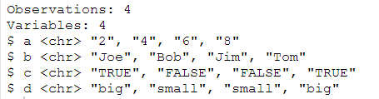
Operations Across Datasets
lapply() is a useful function to perform any operation across a dataset.
lapply() returns a list; sapply() is the same but returns a vector
General form:
lapply ( dataset, function(x) somefunction )
We can use lapply to convert all of the variables in df2 to characters at the same time.
df3=lapply(df2,function(x)as.character(x))
lapply() returns a list; let’s put this into a dataframe.
df3=data.frame(df3,stringsAsFactors = F)
glimpse(df3)

Slide 57
Operations Across Variables/Datasets
Group Exercise
Form groups of 4-5
Be prepared to present for 2 minutes on results
Read in the dataset “crime.csv”.
Convert all variables to character type. Then replace all ?s with NAs.
Count the number of NAs for all variables in the dataset.
Hint: You should use the lapply() and ifelse() functions.

